Slide 1

An Exploration of Mental Health in the Tech Industry
Presented by:
Bryan Alcazar
Jenie Nam
Quaid Scrivens
QinQin Zha
January 23th, 2020
UCI Bootcamp Project

Slide 2
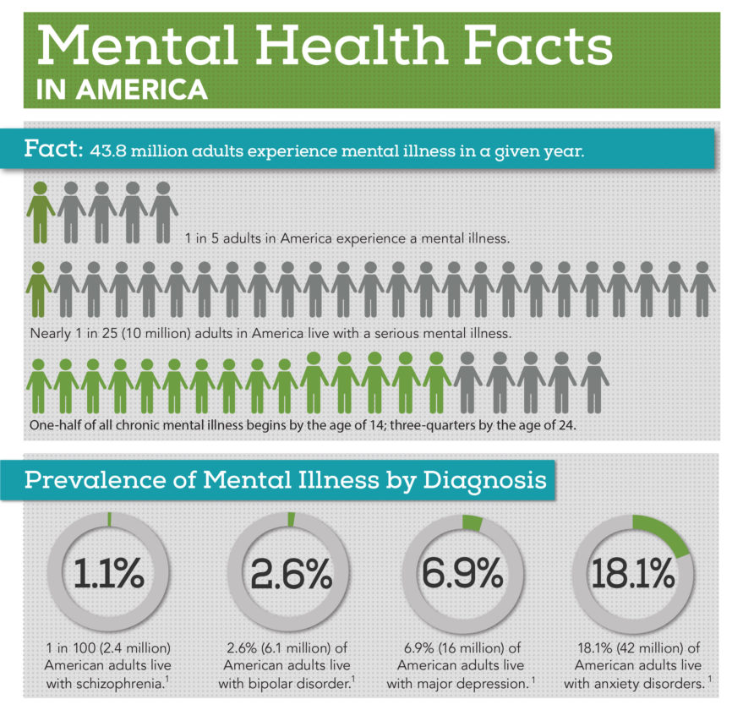
Mental Health Issues are Common in the United States
10 million adults in American live with a serious mental illness, according to the National Alliance on Mental Illness.

Slide 3
Questions:
Has the perception of mental health changed in the workplace?
How does the perception of mental health compare to that of physical health in the workplace?
Has the awareness of mental health changed over time?

Slide 4
Project Flow Chart
Team discussion about the interested topic and source dataset
Each team member focus on different year’s csv to clean up the data based on the specific survey questions asked
Data plot based on the cleaned dataset
Data analysis, discussion and draw conclusion
Notes:
cleaning

Slide 5
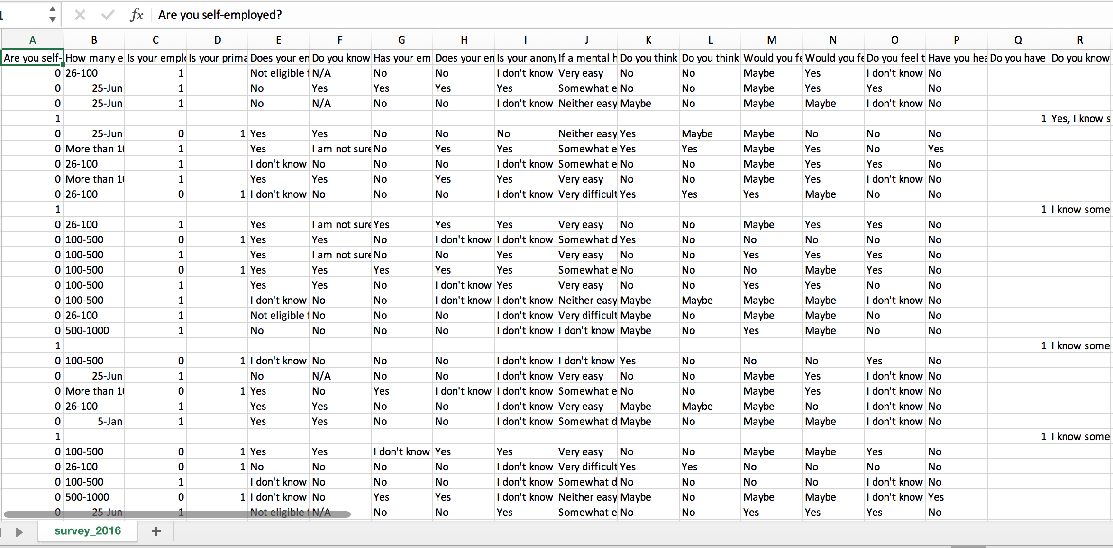
Introduction to the Data:
The Survey csv from Kaggle

Slide 6
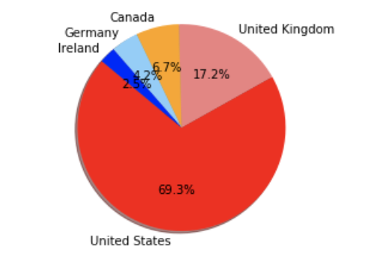
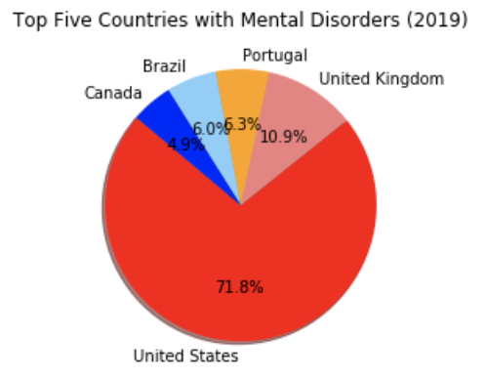
Top Five Countries by Number of Responses
2014
2019
Notes:
cleaning

Slide 7
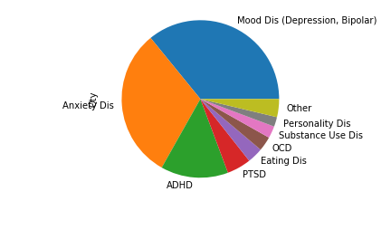
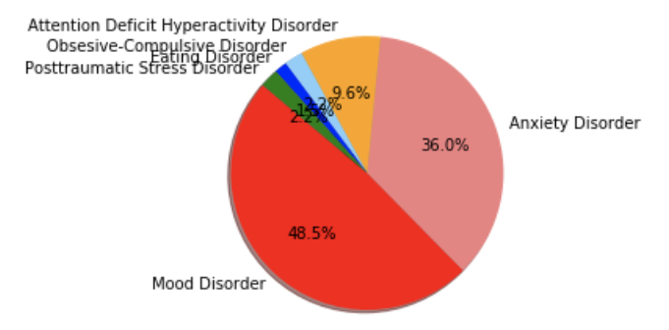
Common Types of Mental Illnesses
Types of Mental Health Disorders (2018)
Types of Mental Health Disorders (2019)
Notes:
cleaning

Slide 8
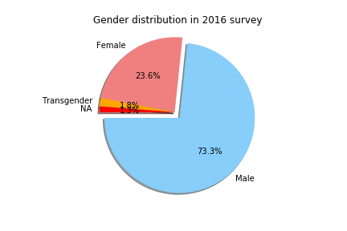
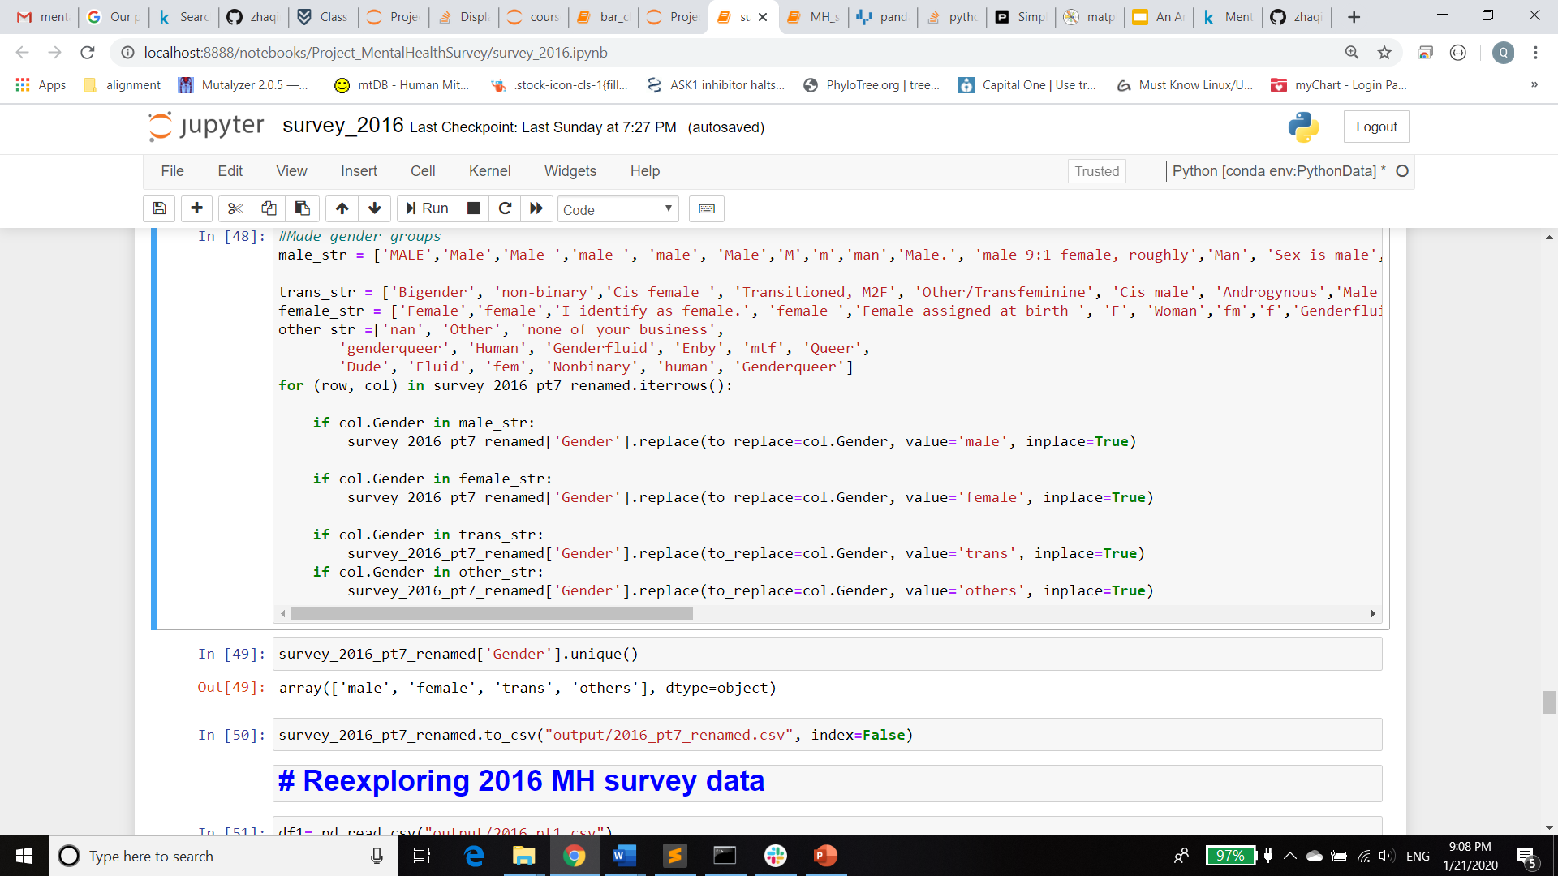
Gender Counts

Slide 9
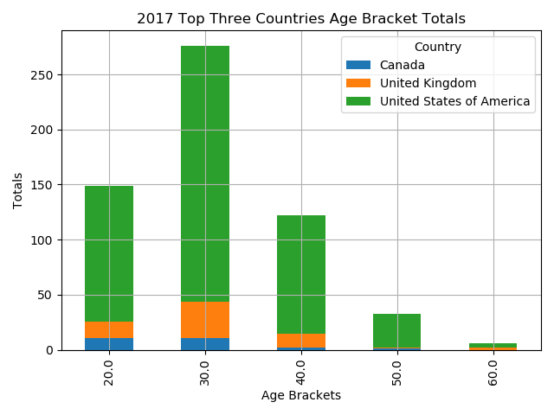
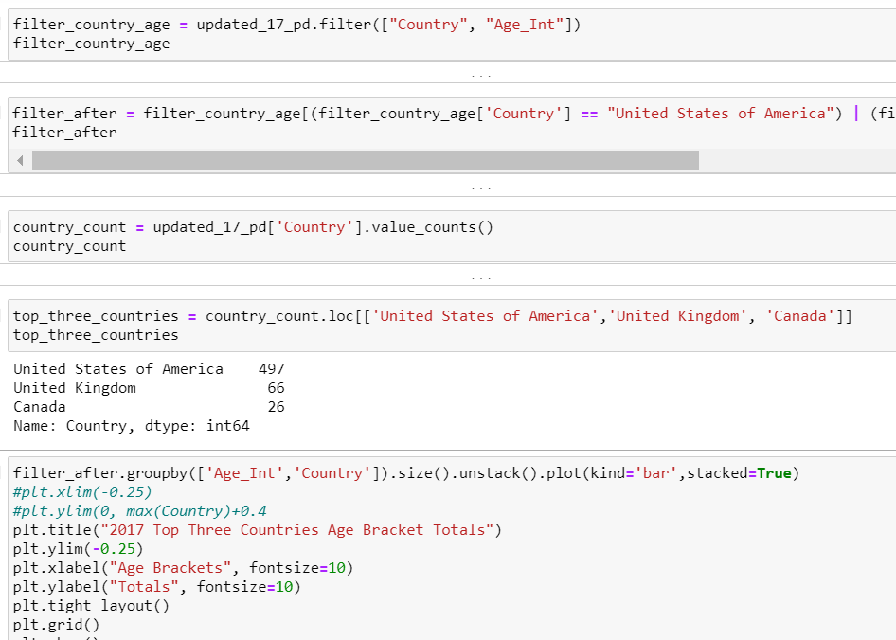
Average Age by Country

Slide 10
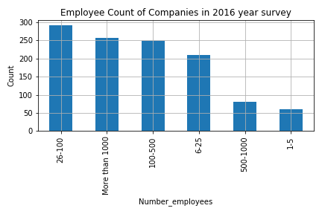
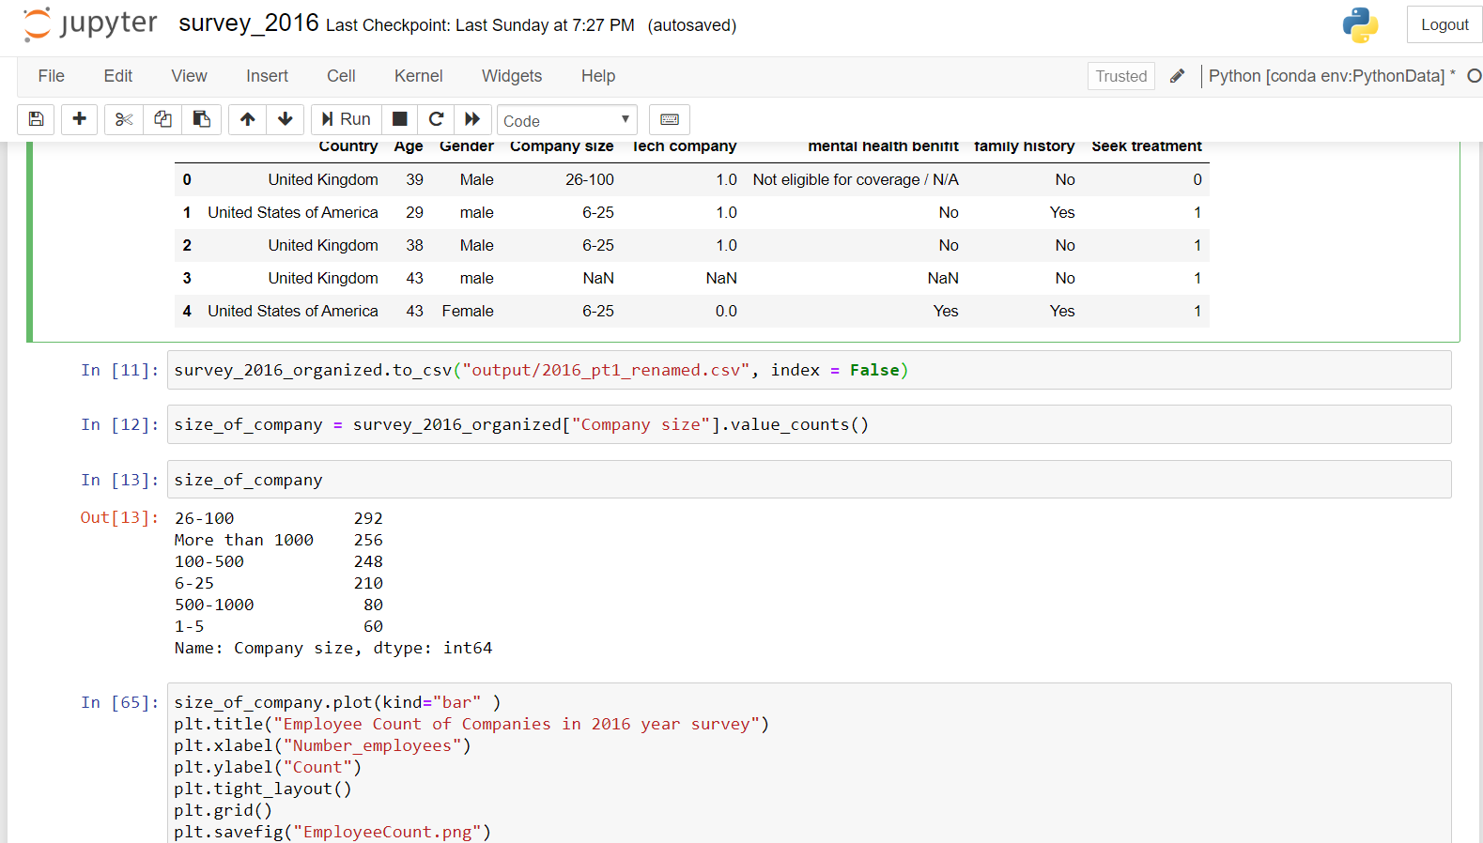
Employee Size of the Companies

Slide 11
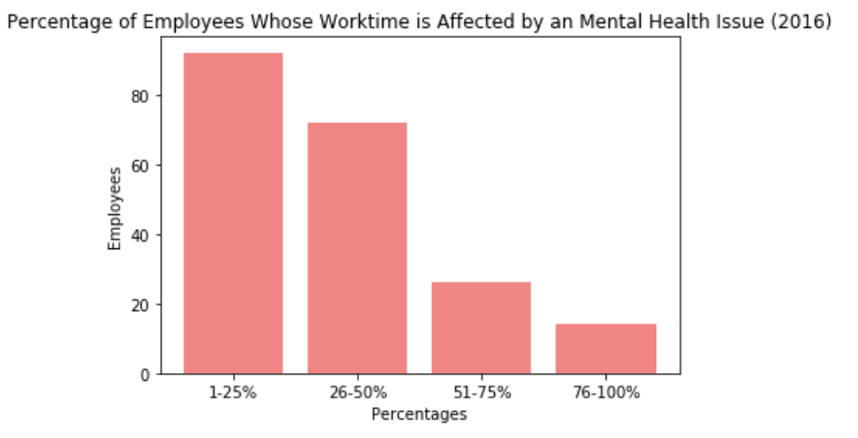
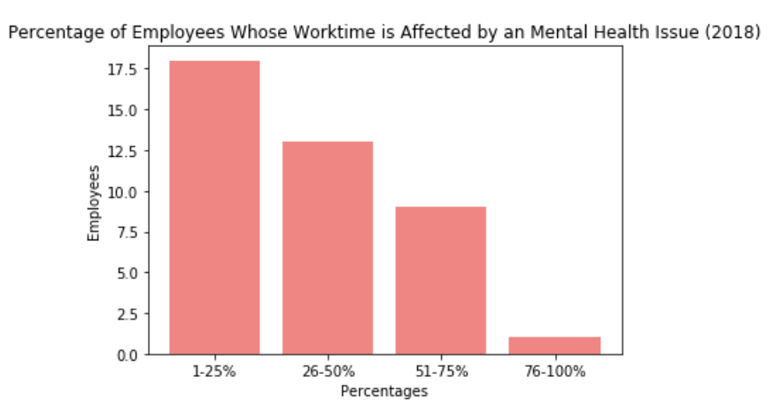
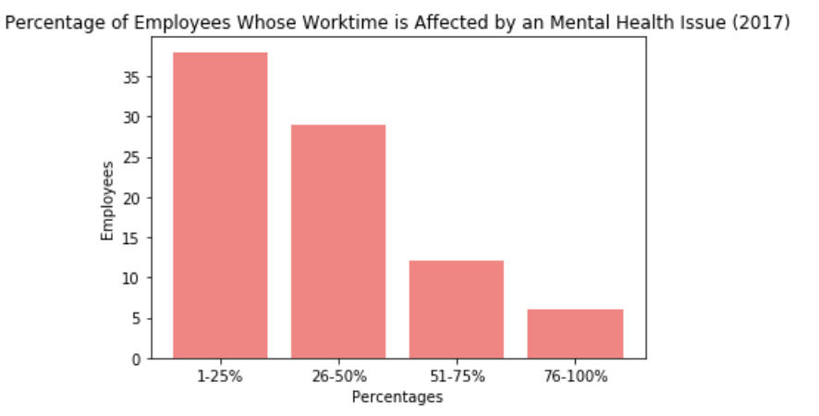
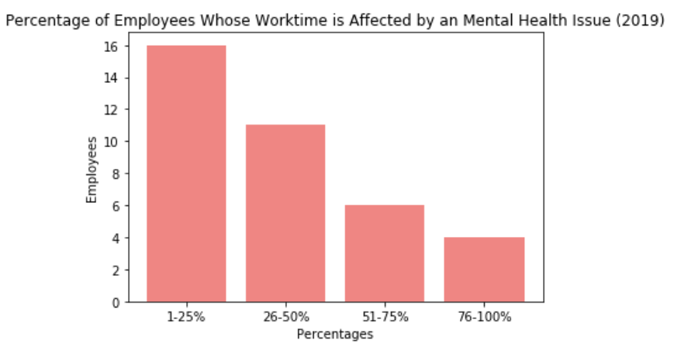
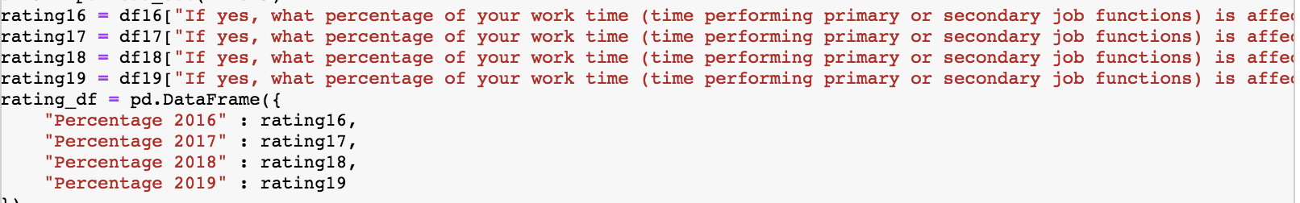
The Effect of Mental Disorders on Work

Slide 12
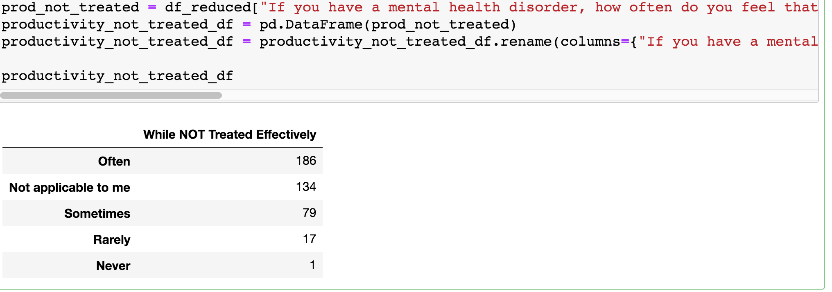
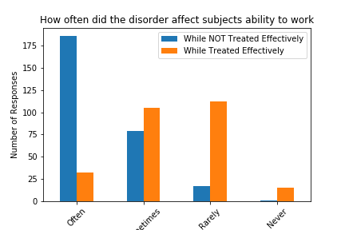
The Effect of Mental Disorders on Productivity

Slide 13
Has the perception of mental health changed in the workplace?

Slide 14
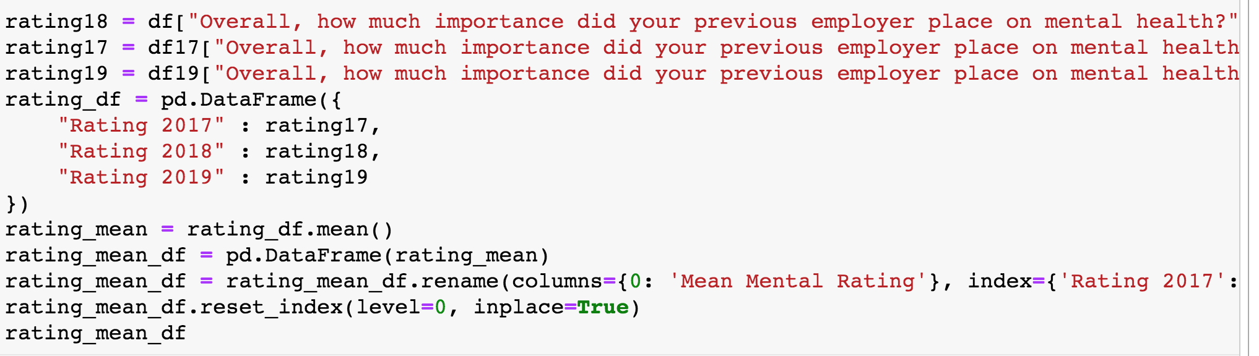
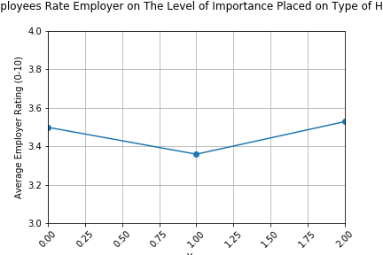
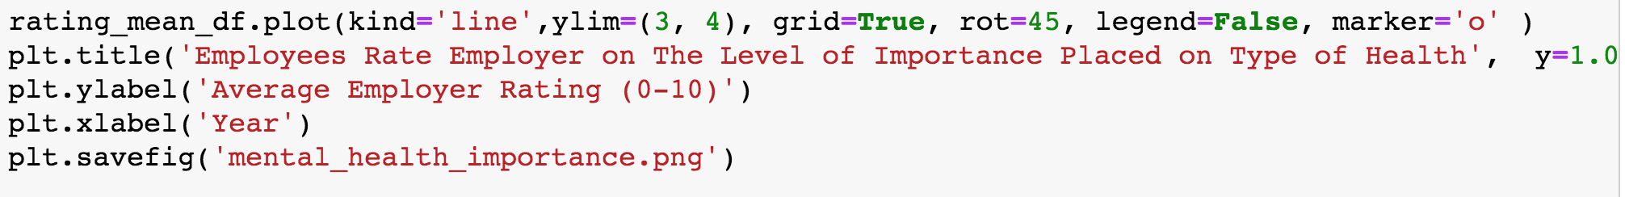
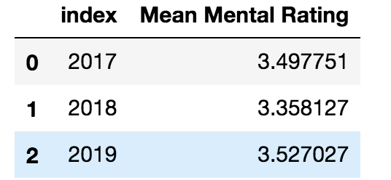
How much importance did your previous employer place on mental health?

Slide 15
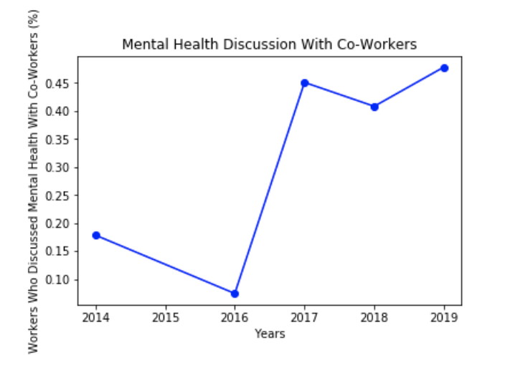
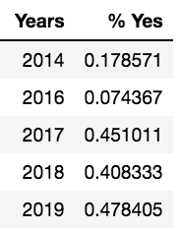
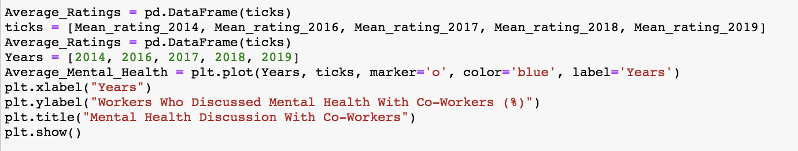
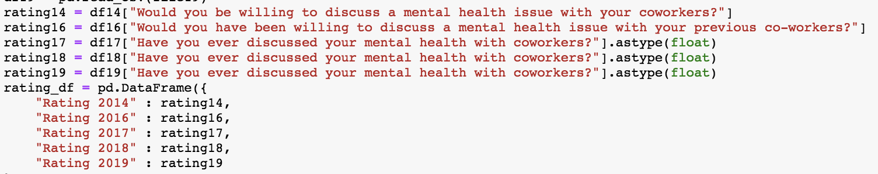
Have you ever discussed your mental health with your co-workers?

Slide 16
How does the perception of mental health compare to that of physical health in the workplace?

Slide 17
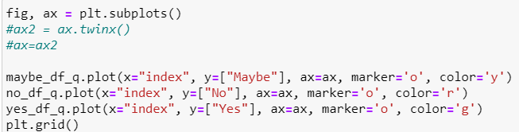

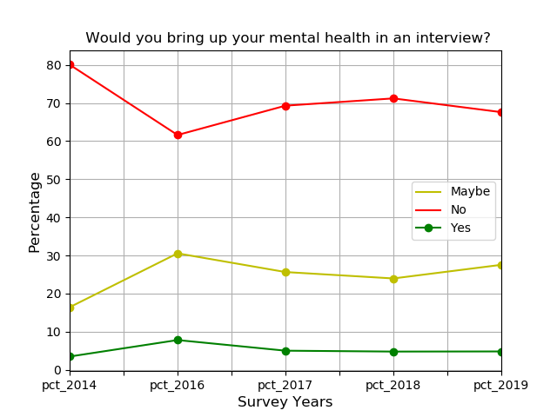
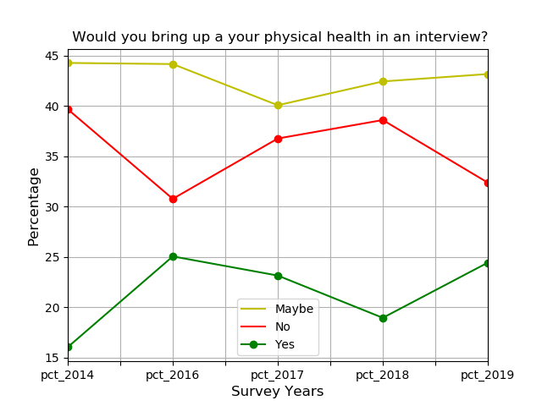
Bring up your mental health vs Physical health in an interview?

Slide 18
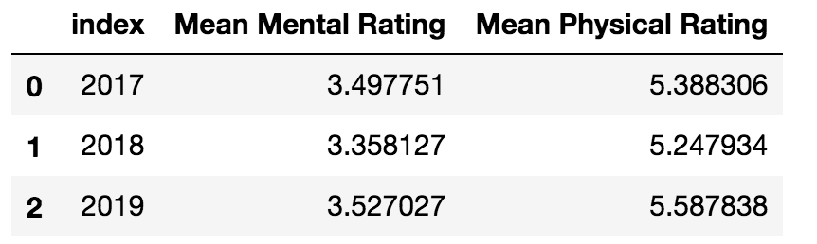
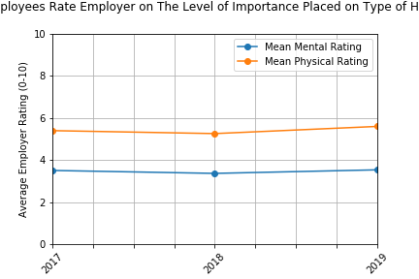
How much importance did your previous employer place on mental vs physical health?

Slide 19
Has the awareness of mental health changed over time?

Slide 20
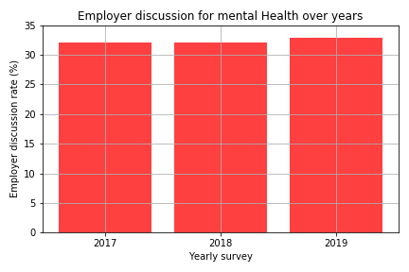
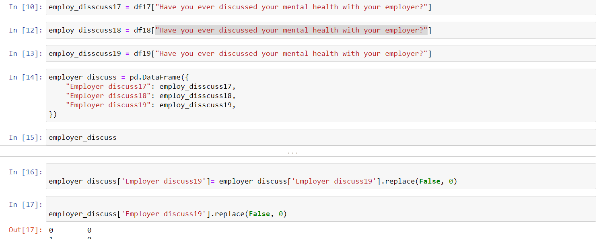
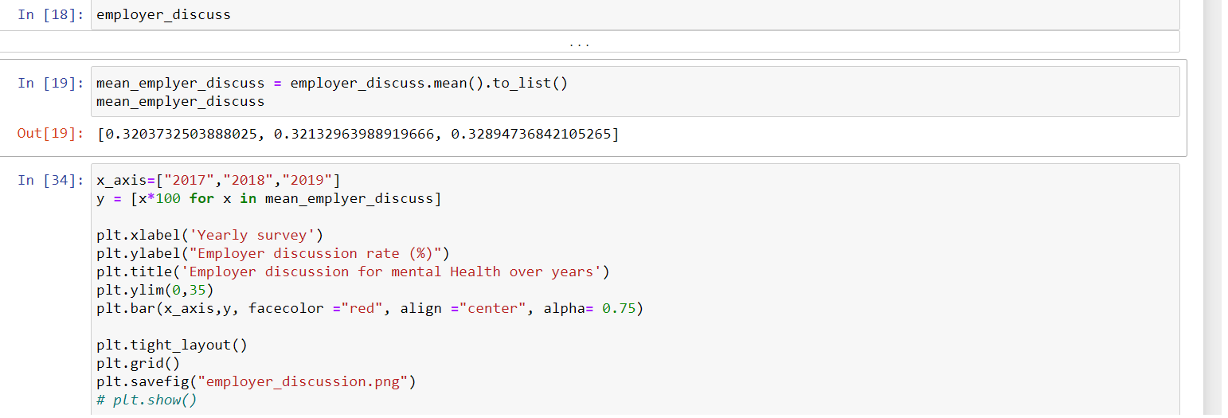
Employer Discussion for Mental Health

Slide 21
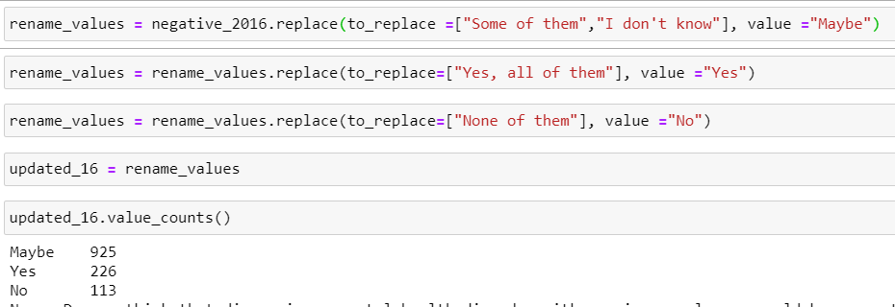


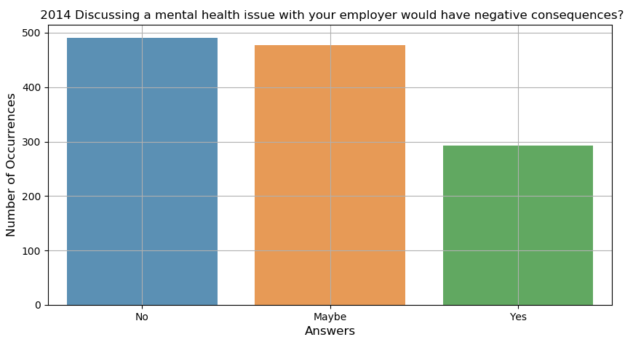
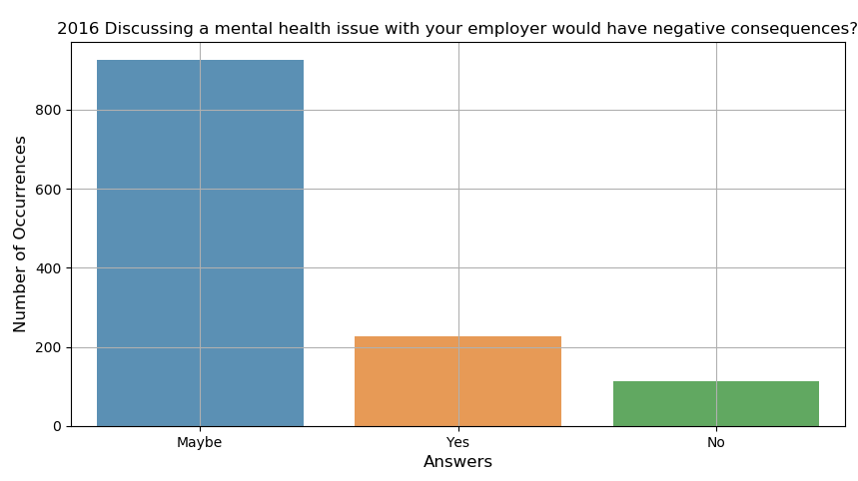
Discussing a mental health issue with employer would have negative consequences?

Slide 22
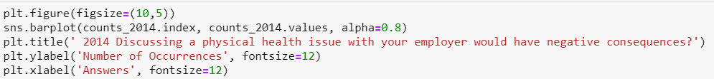
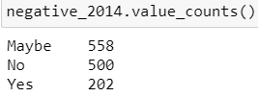
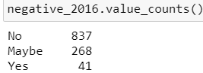
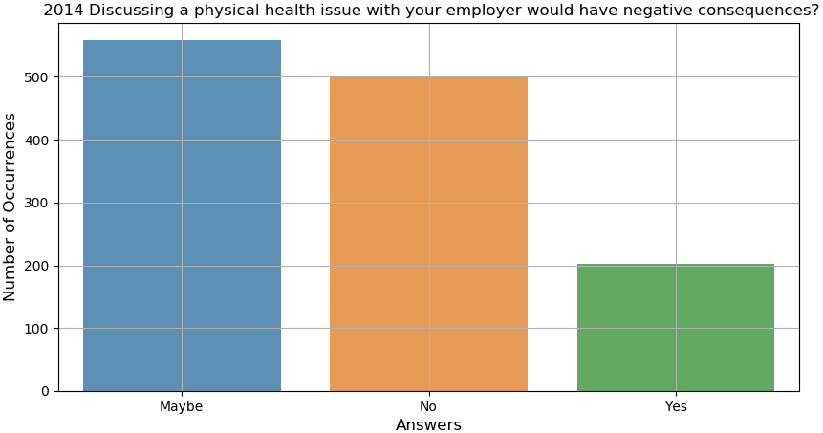
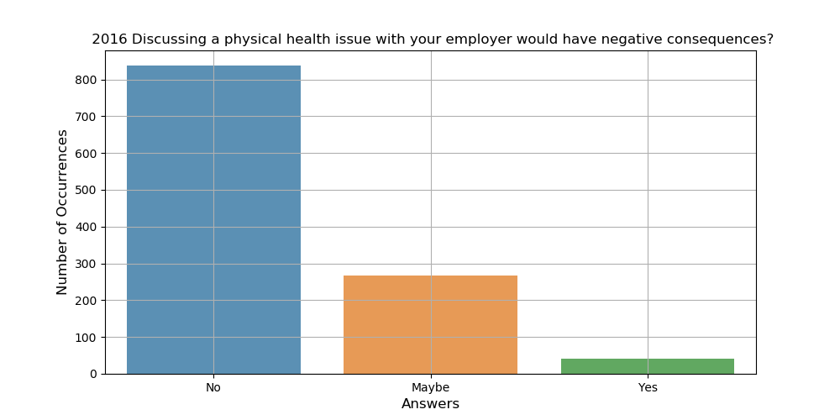
Discussing a physical health issue with employer would have negative consequences?

Slide 23
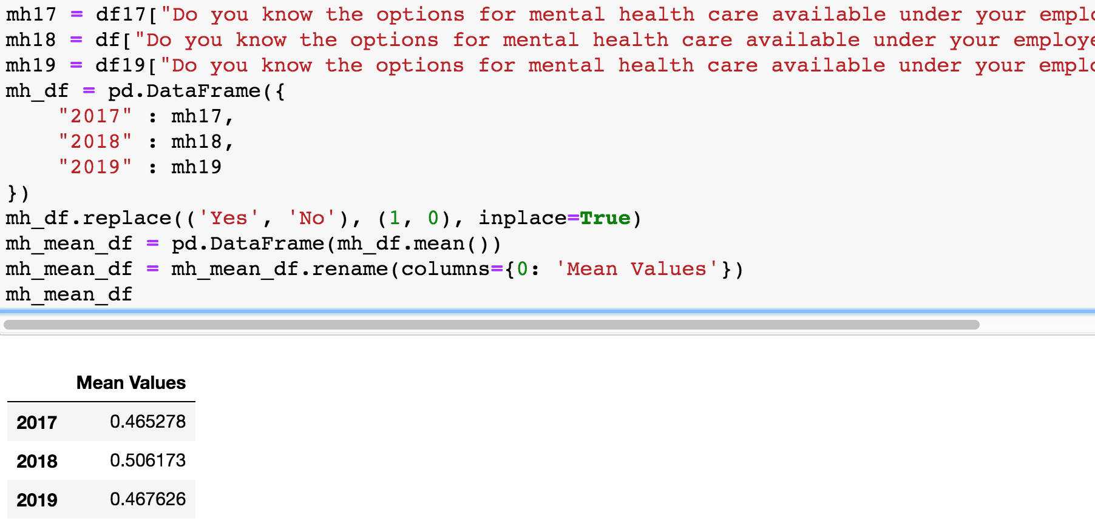
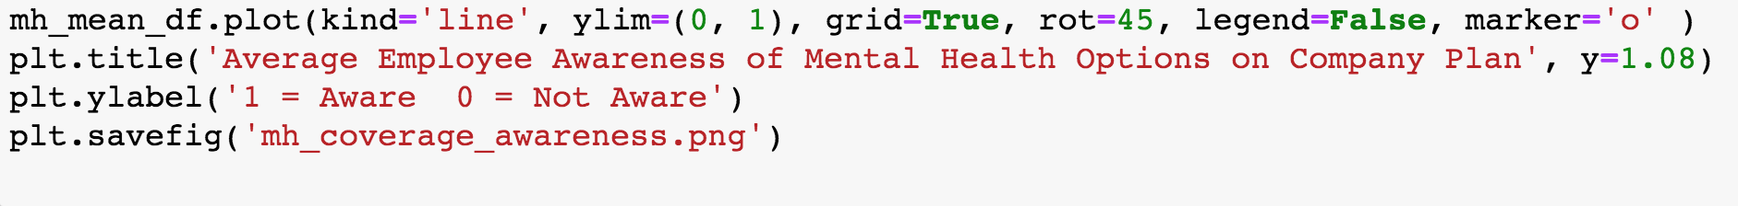
Average Employee Awareness of Mental Health options on Employer’s plan

Slide 24
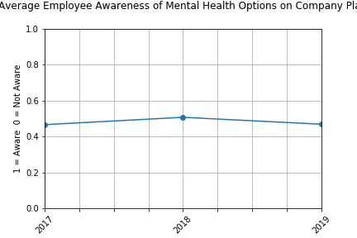

Slide 25
Summary
After plotting the top 5 surveyed countries, United States of America and United Kingdom remain the top two countries where employees in the tech industry struggle with mental health.
Mood disorders (depression, bipolar) are the most common type of metal health issue.
The male participant count is much higher than female participant count (73.3 % vs 23.6% in 2016).
The effect of mental disorders on work productivity is significant between the treated and non-treated group.
On a scale 1-10, Tech industry employers stress mental health at around 3.3~3.5, while physical health is stressed at around 5.3~5.6. (p value =0.000425).
The employer discussion rate has slightly improved with no significance (~32%-33%). The awareness of mental health care option remains 47%-50%.

Slide 26
We need to continue to improve the perception and awareness of mental health and support those who are struggling!

